Slide 1

Eric Frenette
Université Laval
Sébastien Béland
Université de Montréal
Nadine Talbot
Université du Québec à Trois-Rivières
Marie-Hélène Hébert,
Pier-Olivier Caron
TÉLUQ
Measurement Issues: The Case of the Confirmatory Bifactor Model

Slide 2
OUTLINES
Objective
Bifactor (historical perspectives and assumptions)
Methodology
Results
Scientific or scholarly significance

Slide 3
OBJECTIVE
  Increasing number of scientific papers (mainly after 2010) are being published using the Bifactor model
  Some applications may be limited due to its restrictive assumptions
  Historical perspective (Holzinger, 1935; Spearman, 1927) to understand its origin and assumptions
Years | Results
1930 – 1939 | 8 results
1940 – 1949 | 16 results
1950 – 1959 | 13 results
1960 – 1969 | 2 results
1970 – 1979 | 5 results
1980 – 1989 | 5 results
1990 – 1999 | 5 results
2000 – 2009 | 99 results
2010 – 2019 | 3 100 results
2020 – 2024 | 3 300 results

Slide 4
BIFACTOR MODEL
Spearman (1927). The abilities of man. McMillan
  Spearman’s Two factor theory
  One general ability (g) and many specific abilities (s)
  Group factors based on tetrad differences
  Model with one common factor (Thurstone, 1935)

Slide 5
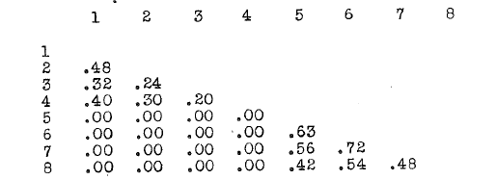
BIFACTOR MODEL
Holzinger (1935-1937). Preliminary report on Spearman-Holzinger unitary trait study (Vol. 1-9).
Extension on the Two factor theory of Spearman (1927)
In Vol 5 a new factor theory called Bi-factor or hollow staircase (p. 1)
Use of the residual correlations after the removal of the general factor
The residual correlations are found to be negligible, the tetrads of the original variables are also insignificant
In Vol 7, coefficient of belonging B for identifying group factors
One common factor model

Slide 6
Unidimensionality
Idea of unidimensionality refers to the dominant concept (or factor) for which the test is designed (Humphreys, 1985, 1986). Several statistical indices are commonly used for this purpose.
  The Explained Common Variance (ECV)
  The Percentage of Uncontaminated Correlations (PUC)
  The scree plot (Cattell, 1966) and parallel analysis (Horn, 1965)
  Velicer’s Minimum Average Partial (MAP) test (1976)
  DETECT, DIMTEST, POLY-DIMTEST or UniCo

Slide 7
METHODOLOGY
Research the term ‘Bifactor’ (or Bi-factor) in seven scientific journals:
European Review of Applied Psychology (n=3/5);
Contemporary Educational Psychology (n=12/28);
Journal of Educational Psychology (n=10/16);
Journal of Vocational Behavior (n=17/31),
Learning and Individual Differences (n=14/25),
Personality and Individual Difference (n= 86/154)
Scandinavian Journal of Psychology (n=7/10)
269 scientific papers; 149 use a confirmatory bifactor model; 143 with fit indices

Slide 8
RESULTS
Table 2: Summary of confirmatory Bifactor model assumptions
Evaluation Criterion | Number of Studies (N = 143) | %
1- Robust unidimensionality demonstrated | 35 | 24.5 %
2- Statistical identification of group factors
residual correlation analysis (Holzinger-style) | 1 | 0.7 %
belonging coefficient or tetrad tests | 0 | 0.0 %
exploratory methods (EFA, free structure search) | 7 | 4.9 %
Purely theoretical or imported group factor structure | 52 | 36.4 %
3- Studies meeting both key conditions (1 + 2) | 1 | 0.7 %

Slide 9
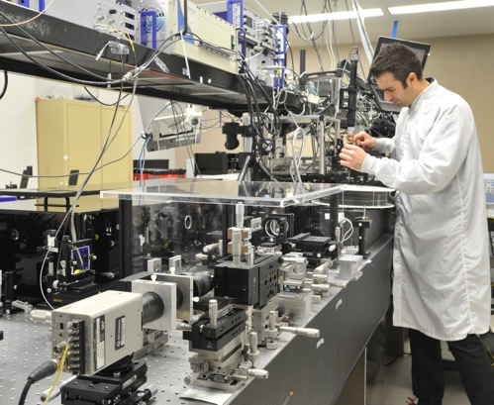

SCIENTIFIC SIGNIFICANCE
Historical perspective of the Bifactor model
Using confirmatory Bifactor model without respecting its assumptions is a questionable research practice
Group factors: missing software implementing tetrad criterion, or the coefficient of belonging B and the residual correlations
Unidimensionality : a lot of methods available

Slide 10
SCIENTIFIC SIGNIFICANCE
What is a Bifactor model ?
Over time different propositions aliterate the Bifactor model, adding to the confusion.
Burt (1937), Delaporte (1947), Schmid and Leiman (1957), Gibbons and Hedeker (1992) IRT Bifactor model, Gignac’s model (2006, 2008) based on Catell’s model (Gf, Gc)

Slide 11
SCIENTIFIC SIGNIFICANCE
Recommendation using the confirmatory Bifactor model:
Do the authors really used a Bifactor model?
Assessment of unidimensionality?
How are the group factors identified?
Most authors use Gignac's model (calling it Bifacteur), where unidimensionality is theoretical and group factors are replaced by common factors. It all boils down to a race to the bottom in terms of fit indices.

Slide 12


